Slide 1
Microscopes
"The evolution of a science often parallels the invention of instruments that extend human senses to new
limits." (Campbell 2002)

Slide 2
Compound Microscope
Fluorescence microscope
Phase-contrast microscope
Transmission electron microscope (TEM)
Scanning Electron Microscope (SEM)
Scanning Probe Microscope (SPM)

Slide 3
Optical…compound…light…?
Confused? Don’t be!
Any “optical” microscope is a microscope that uses visible “light” and lenses to magnify images of small samples.
Compound microscope uses series of lenses.
Simple/Single lens microscope only uses one lens.

Slide 4
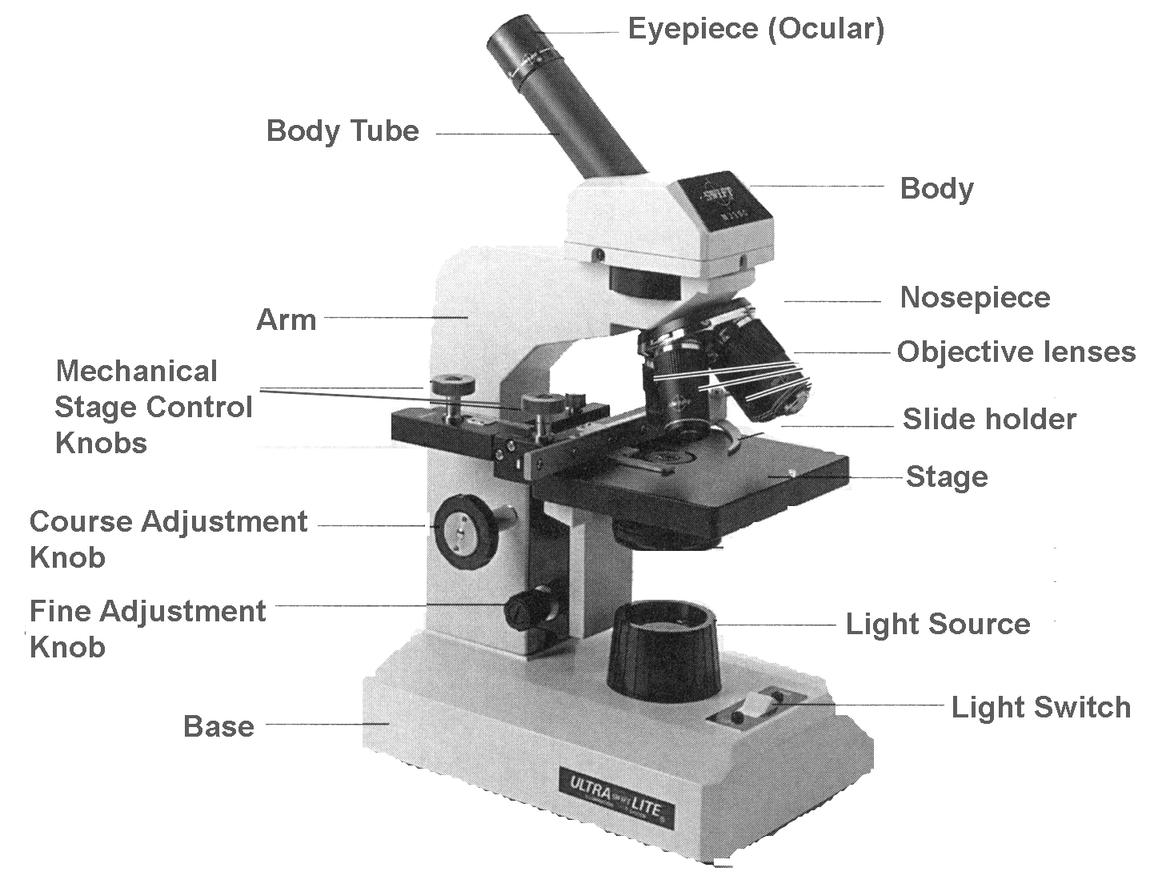
Compound Microscope
uses multiple lenses to collect light from the sample and then an another set of lenses to focus the light into the eye
Invented: 1609: Galileo Galilee

Slide 5
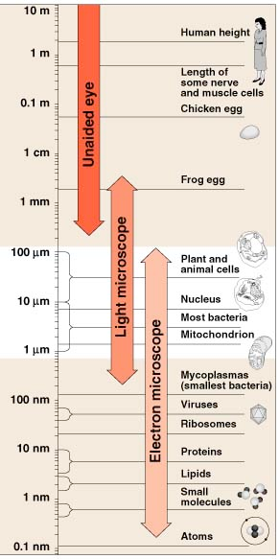
Light Microscope: passes visible light through a specimen & series glass lenses that magnify the specimen
1665: Robert Hook: First cell discovered (simple optical microscope)
Light microscopes are effective in magnifying images up to
1000x.
Limitations:
The smallest wavelengths of visible light are too large to resolve images smaller than
0.25 micrometers (um).

Slide 6
Fluorescence microscope
Another form of “optical/light” microscope
Specimen/sample is illuminated with a specific light of a wavelength which “excites” the florescence within the specimen/sample.
In other words, the specimen receives some light, absorbs it, then makes its own light (and that’s what we see & measure)
Invented in 1911

Slide 7
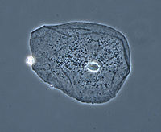
Phase-contrast microscope
Optical/light microscope
particularly important in biology-
reveals many biological structures that are not visible with regular light microscopes
Light travels through the specimen, and light “bends” to reflect the properties of the material it is passing through
Invented in 1940s-Frits Zernick

Slide 8
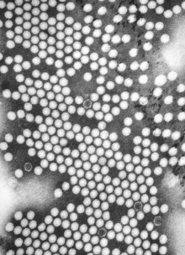
Transmission electron microscope (TEM)
150,000 x
1931-Knoll & Ruska
Electrons are used to produce
magnified images
Electrons pass through specimen and produce flat image

Slide 9
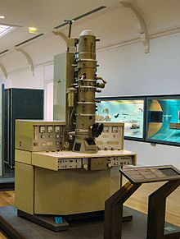
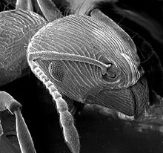
Scanning electron microscope (SEM)
150,000 x
1926- Hans Busch
Electrons are used to produce magnified images
Electrons bounce off the surface of specimen and produce 3D image

Slide 10
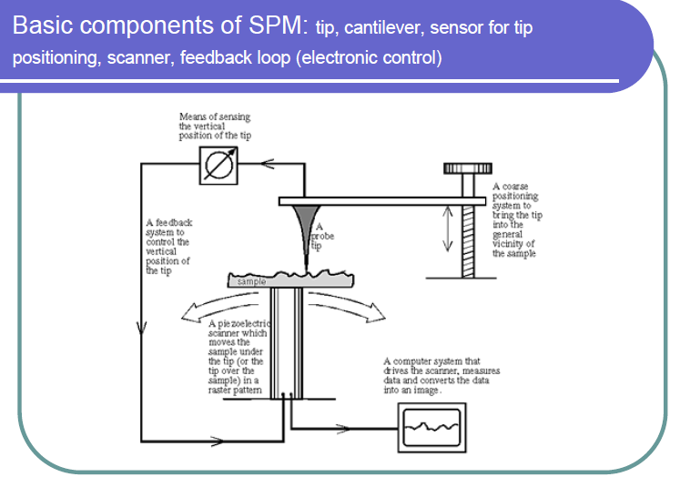
Scanning Probe Microscope (SPM)
Uses physical probe that scans the specimen
The probe scans the specimen line by line
Invented in 1982 by Binning and Rohrer
It really doesn’t “magnify” things. It can detect things as small as 1 billionth of a mm (pico-meter)

