Slide 1
Hydrology (fresh water) Part 3

Slide 2
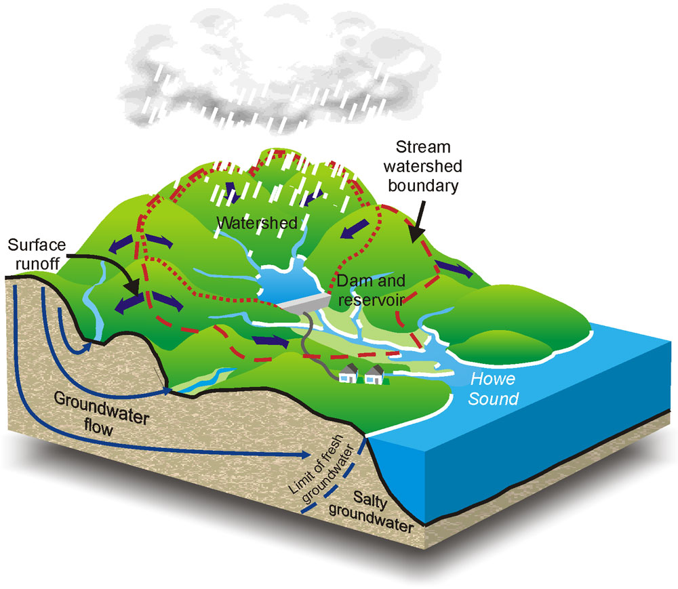
Type of run off: watershed

Slide 3
Water shed is an area of land that drains into a river or lake.
Also called “drainage basins or river basins”
Can be effected by development such as buildings and roads.
If the water flows too quickly and will not soak into the soil which causes flooding.
If there is little vegetation in the area, runoff can carry away the soil and damage the ecosystem.

Slide 4
How do humans use water?

Slide 5
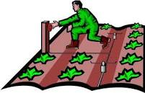
All good answers but….
The main use is for irrigation. Irrigation is the use of artificial methods to supply water to plants-mostly food crops and lawns.
70% of world wide water usage by humans= irrigation.

Slide 8
Recreational Use- 1%

